Slide 1
VMR @ Virginia
Scott Acton (co-PI), Kevin Skadron (co-PI),
Donnie Newell, Rituparna Sarkar, Matthew Yu

Slide 2
Overview

Slide 3
Overview
Many types of image descriptors
Shape, Color, Local Features, Texture
Different images are better suited for different descriptors.
Picture of a window better suited for local features than shape
Explored how to dynamically choose most appropriate method to improve results

Slide 4
structure

Slide 5
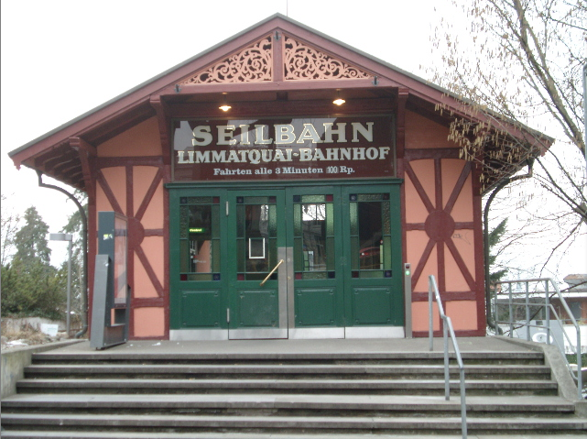
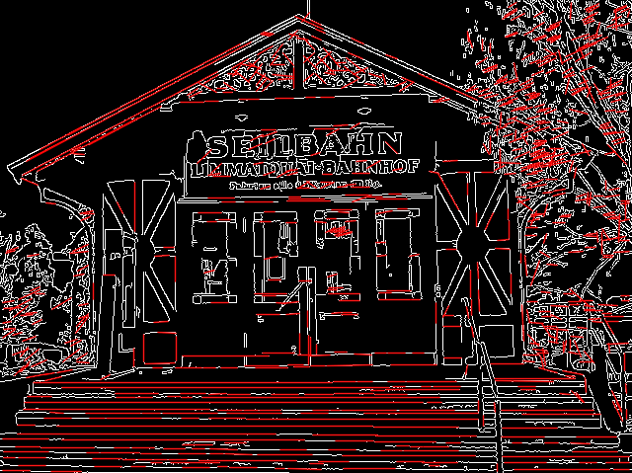
Structure
original
Canny w/ hough

Slide 6
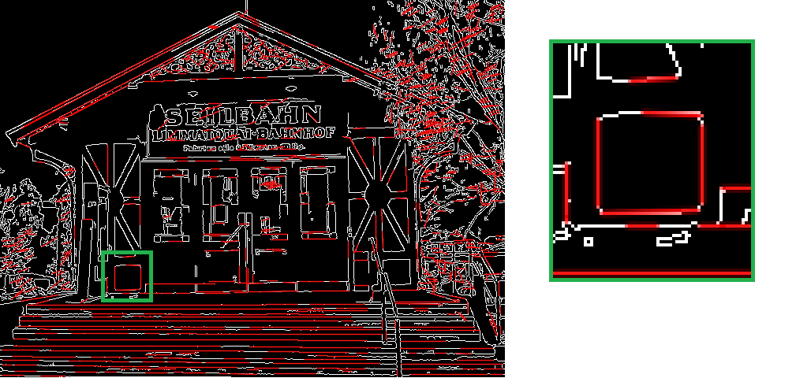
Structure

Slide 7
Self-nomination
Using structure to decide

Slide 8
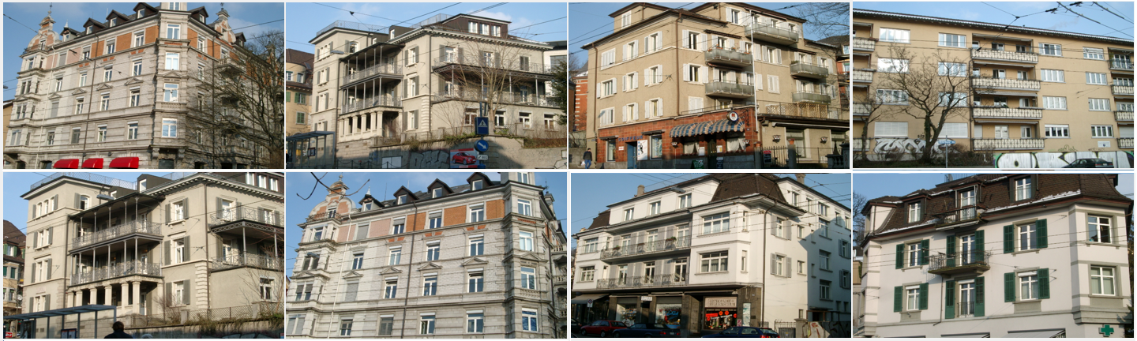
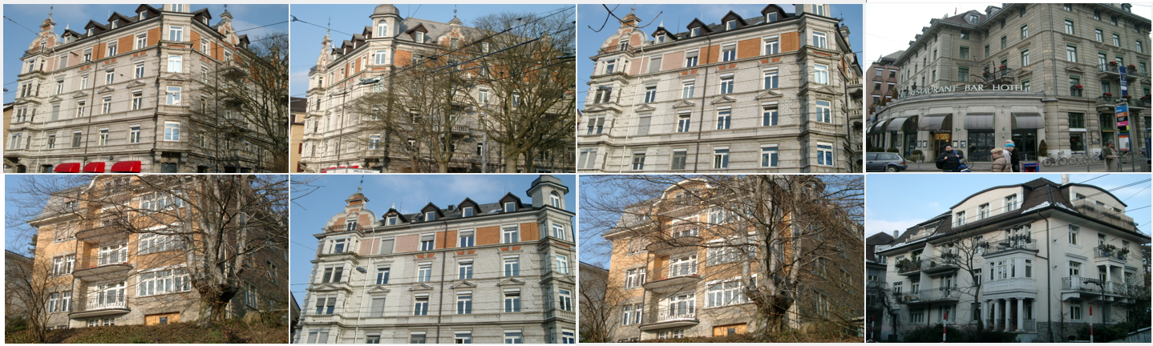
Structure Self-Nomination
HSV
SURF

Slide 9
Image Database
ETH Zurich Buildings
Google Image Search
Caltech 101
100 – ak47
19 – helicopter
20 – landscape
250 – building
66 – rpg
13 – military vehicles
451 – clutter

Slide 10
Segmentation and shape based Matching

Slide 11
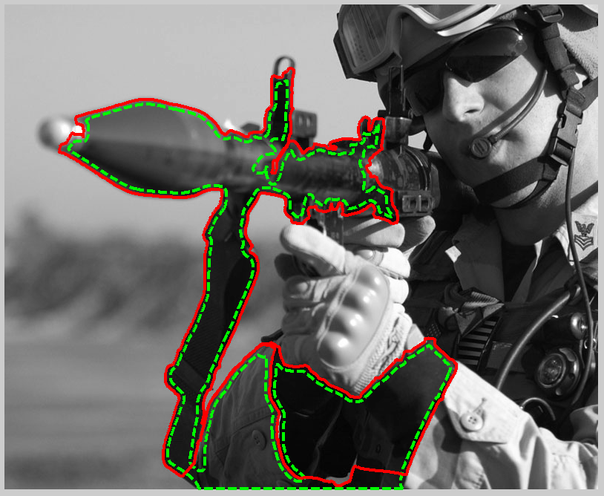
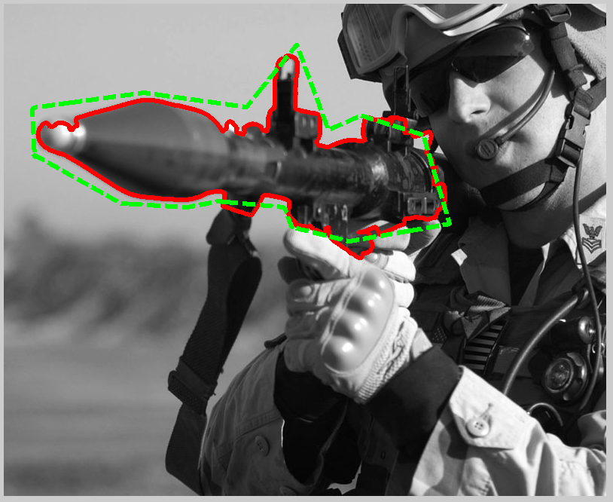
Segmentation
(a) PIG initialization (automated initialization) | (b) Manual initialization

Slide 12
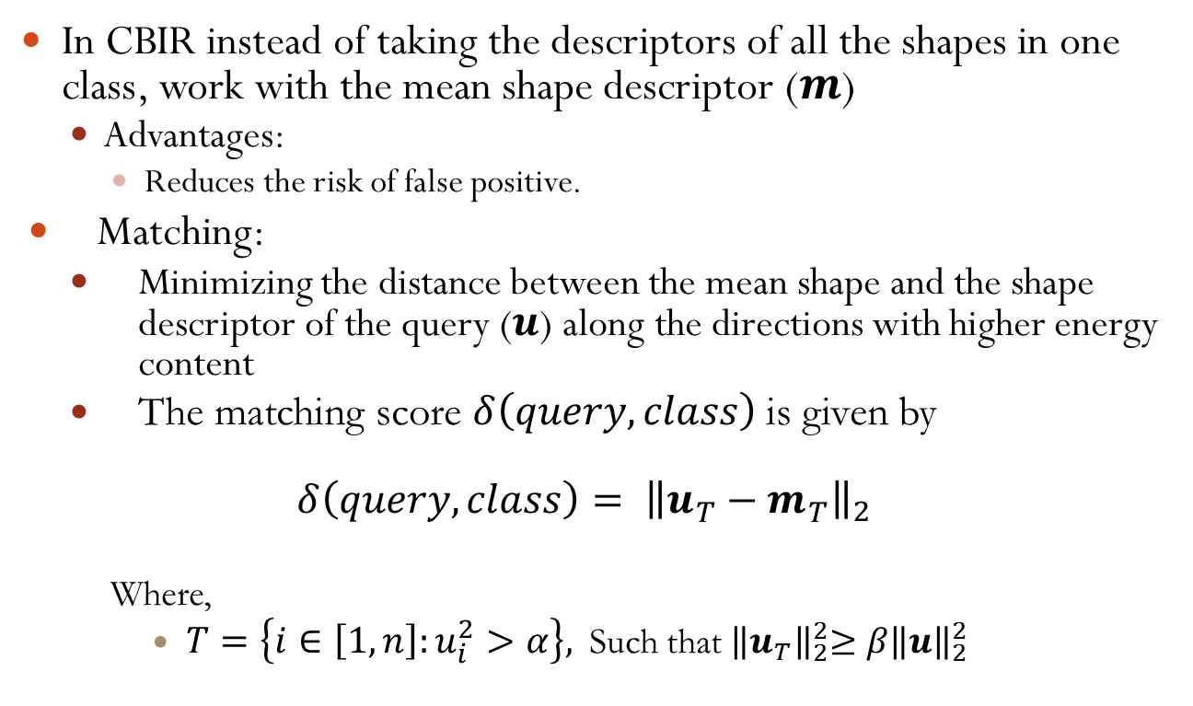
Shape Based Matching
In CBIR instead of taking the descriptors of all the shapes in one class, work with the mean shape descriptor ($m$)
Advantages:
Reduces the risk of false positive.
Matching:
Minimizing the distance between the mean shape and the shape descriptor of the query ($u$) along the directions with higher energy content
The matching score $δ\left(query,class\right)$ is given by
$δ\left(query,class\right)= {\left\|u_{T}^{}−m_{T}^{}\right\|}_{2}$
Where,
$T=\left\{i∈\left[1,n\right]:u_{i}^{2}>α\right\},$Such that${ \left\|u_{T}\right\|}_{2}^{2}≥β{\left\|u\right\|}_{2}^{2}$

Slide 13
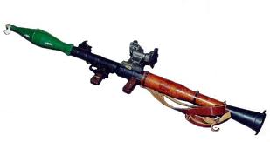
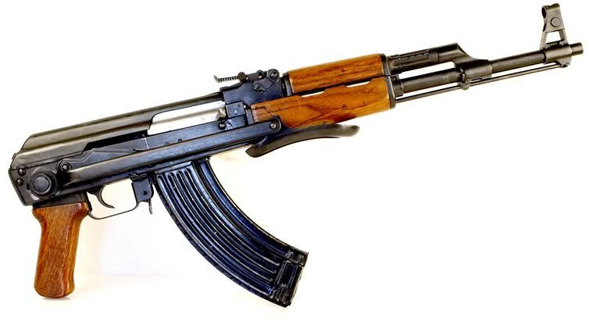
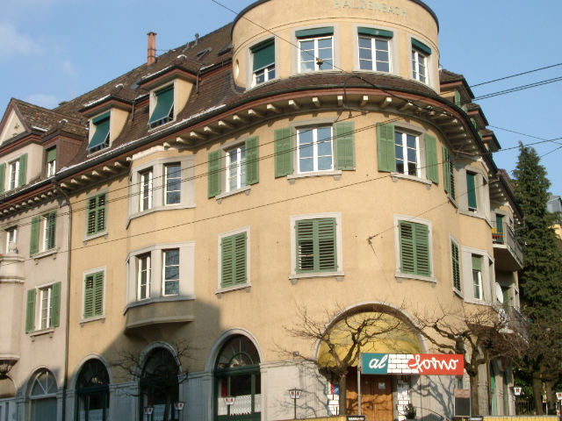
Results based on shape based matching
Closest shape
Next probable classes

Slide 14
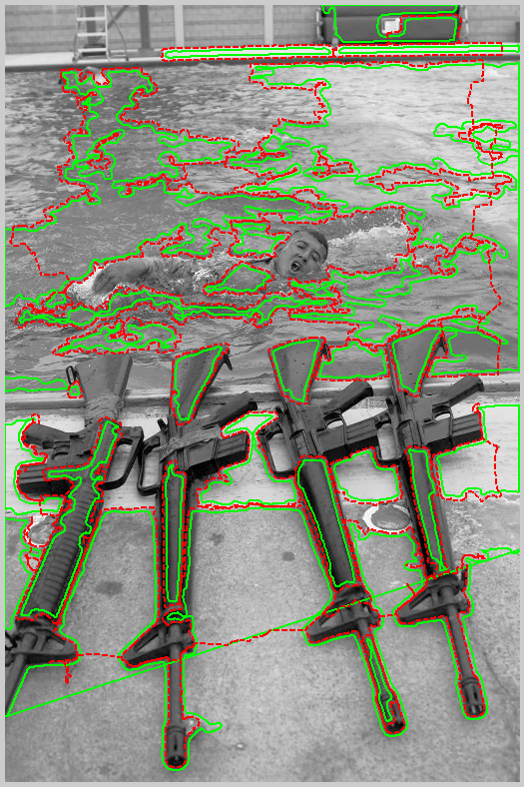
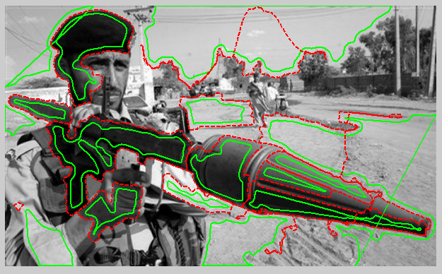
Modification on Segmentation
Delete undesired segments (land, sky, water etc.).
Merge Segments similar based on certain characteristics
Delete segments with less number of pixels

Slide 15
Texture Self Nomination

Slide 16
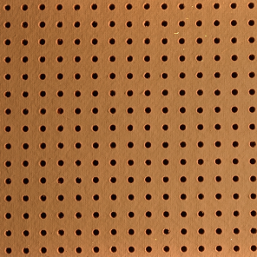
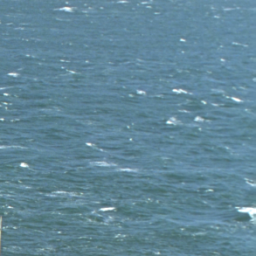
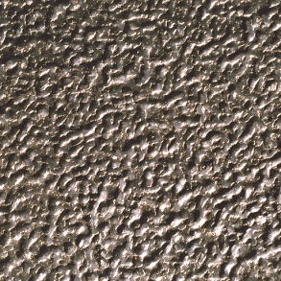
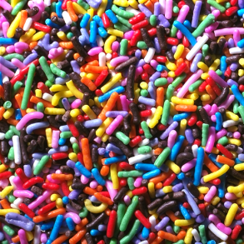
Texture
Why is texture important?
When is texture important?
Notes:
Introduction - talk about textures, when is it important for query? (perhaps lots of circles = find images with logs of circles)
May leave out if it’s unnecessary

Slide 17
Texture Self Nomination
Hypothesis
How “structured” or “random” the texture appears suggests what feature is important
Example measures/features of “structuredness”:
Entropy, Local Binary Pattern, Cooccurence Matrix
Observations
Images can be grouped based on max Haar Wavelet Coefficients in the hue channel
Handle each group separately
Notes:
-For the VMR presentation, I am only using Entropy and Local Binary Pattern. Cooccurrence matrix is unused.

Slide 18
Texture Self Nomination Algorithm
Given a query image:
Calculate its Local Binary Pattern entropy
Calculate the max Haar Wavelet coefficients
Depending on threshold and group, use the appropriate feature vector to find matches
Notes:
Algorithm overview
-Given a query
-Calculate its local binary pattern histogram (using V channel in HSV) and then the entropy of that
-Calculate the max Haar wavelet coefficients in the following:
-H channel in the HSV of the image after zeroing out the U channel in YUV
-H channel in the HSV of the image after zeroing out the V channel in YUV

Slide 19
Texture Features Precision
Presegmented Database of guns, RPGs, buildings, and vehicles
150 Randomly selected images from database used as query images.
Top 10 closest matches reported
Feature | Average Number of Correct Matches
Color Histogram | 5.38
Gabor Filter Reponses | 6.18
Fractal Dimensions | 6.58
Self-Nomination | 6.73

Slide 20
Building Texture Score
Is the texture from a building?
Observations (using Gabor Filters):
For a given level, buildings tend to have one or two directions with very high responses
For a given level, the responses in the remaining directions tend to be low
Notes:
-Levels refer to the frequency components (high level = high frequency / high pass, low level = low frequency / low pass)
-Quick overview of Gabor Filters:
-filters of the form sin * gaussian in some direction (sine function that dies out like a Gaussian)

Slide 21
Buildingness Score
Calculate Buildingness as follows:
Looking at the two lowest Gabor filter levels
Take the difference between the second lowest filter response and the second highest filter response
Multiply the two numbers together and scale
Notes:
-Scaling is just to make the final value look nice. In the demo, I’ve set it up so that a score of 1 or above is a high building confidence.

Slide 22
Future Work
Generalize and Optimize

Slide 23
Future Work
Information gain to weight features
Dynamically choose algorithms with highest weight
GPU acceleration
Prior work on SURF

Slide 24
Results
Demo

Slide 25
Backup Slides

Slide 26
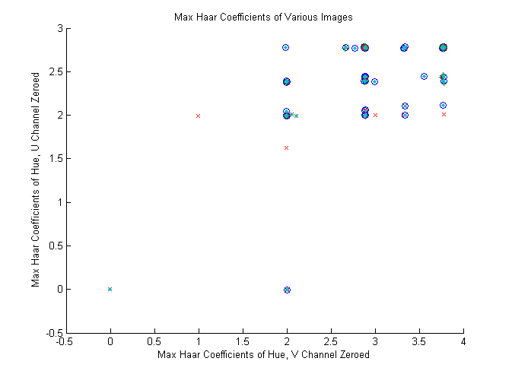
Notes:
-Plots represent which technique works best:
-x – fractal
-o – Gabor
-+ - color histo
-<filled circle> represents query images in which the precision was not 10 out of 10 for any technique
-Some images have more than one technique that works well. These are represented by overlapping plots (ex: the X-Men symbol means both fractals and Gabor work equally well)
In this technique, the plots were randomly displaced slightly to show how many images fall on a spot – many of the very close plots actually overlap. A random selection of 150 images were used as the queries
The take away point here is that Haar wavelets can help classify query images into groups to be handled separately

Slide 27
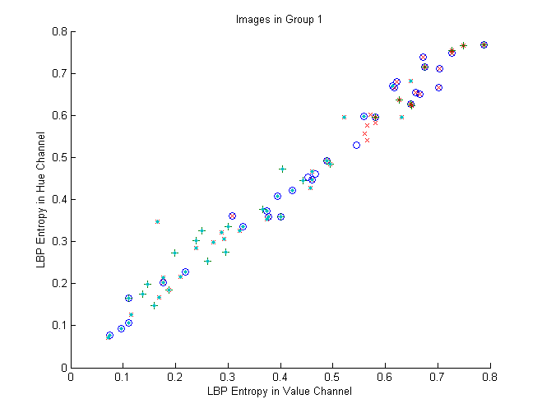
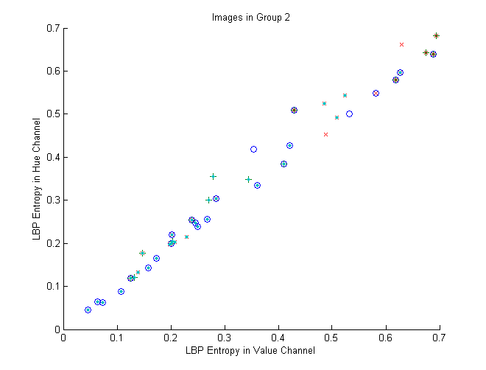
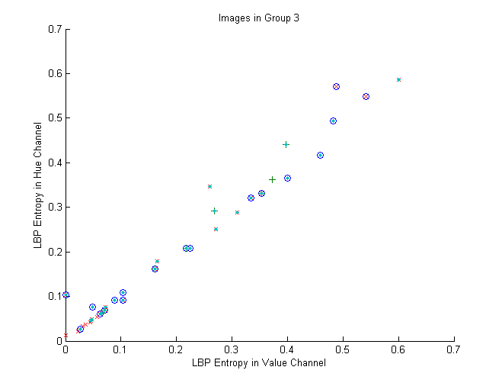
Notes:
Group 1 refers to images in which x>3.5 && y>2.6 in the plot on slide 10
Group 2 refers to images in which x>2.5 && y>2.3 in the plot on slide 10 but not in group 1
Group 3 refers to remaining images not in any of the above groups
Take away point is that Local Binary Pattern is good enough for separating images into which technique works well

Slide 28
Local Binary Pattern
Construct a Histogram as follows:
Initialize an empty 2⁸ bin histogram
For each pixel p0
Initialize an 8 bit long bit-vector V[]
For 8 neighboring pixels p₁ to p₈
If |p0 – p_{n}| > T
V[n] = 1
Else
V[n] = 0
Convert V into an index value and increment the corresponding bin in the histogram

Slide 29
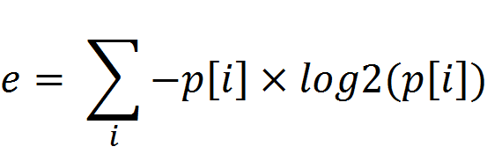
Information Entropy
Summation over all indices i
p[i] – Proportion of values at index i

